Slide 1


Instagram User Analytics
Using SQL

Slide 2
Project Overview
Purpose
      To analyze Instagram user data for marketing and investor insights.
      Provide actionable recommendations to improve user platform performance.
Key Tasks
      Marketing Analysis
      Investor Metrics

Slide 3
Tech Stack
MySQL Workbench 8.0 CE
      For running SQL queries.
      Easy-to-Use Interface for query execution.
MySQL Shell
      Efficient for database management and querying.
      Simple for capturing analysis.
Microsoft PowerPoint
      For presenting report.

Slide 4
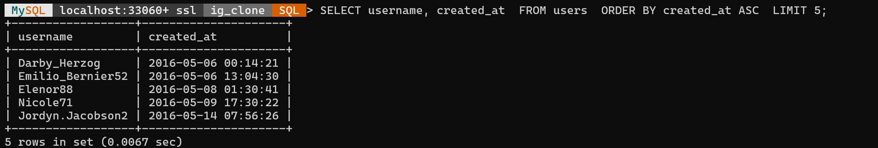
SQL Tasks
Loyal User Reward
      Goal: Identify the 5 oldest users on Instagram.
      SQL Query And Output :
Insight
      The oldest users can be rewarded to improve loyalty and engagement.

Slide 5
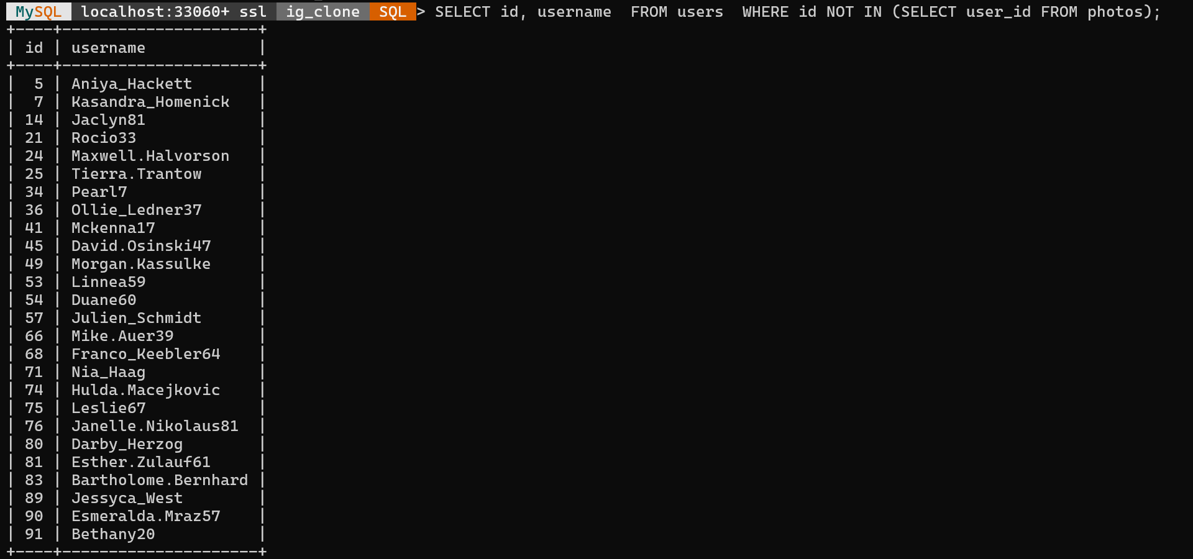
SQL Tasks
Inactive User Engagement
      Goal: Identify users who have never posted a photo.
      SQL Query And Output :

Slide 6
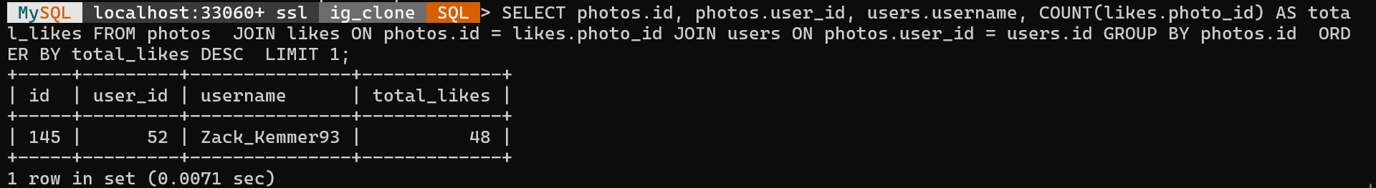
SQL Tasks
Contest Winner Declaration
      Goal: Find the user with the most likes on a single photo.
      SQL Query And Output :
Insight
      This user can be declared as the contest winner.

Slide 7
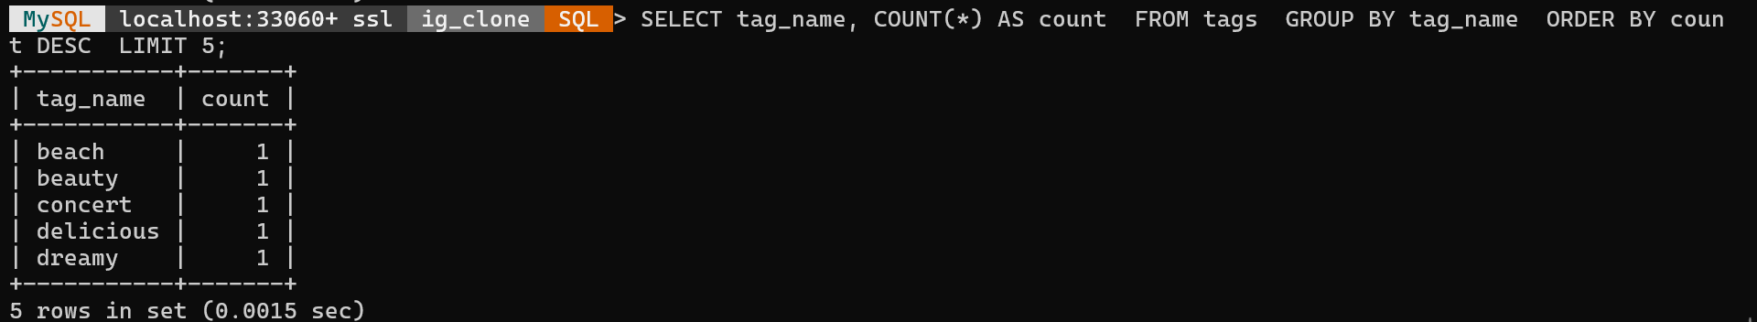
SQL Tasks
Tag Research
      Goal: Identify the top 5 most commonly used tags.
      SQL Query And Output :
Insight
      These tags are most effective for reaching a wider audience.

Slide 8
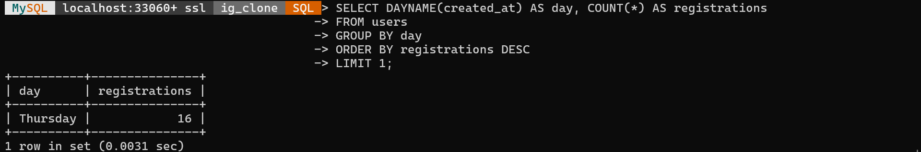
SQL Tasks
Ad Campaign Launch
      Goal: Determine the best day for ad campaigns (based on user registration).
      SQL Query And Output :
Insight
      Ads should be launched on the day with the highest registrations.

Slide 9
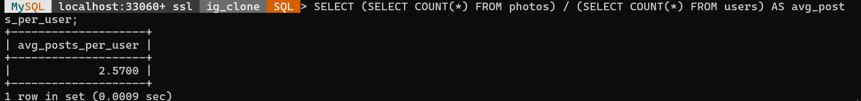
SQL Tasks
User Engagement Metrics
      Goal: Calculate average posts per user.
      SQL Query And Output :
Insight
      Provides investor insight into user activity and engagement levels.

Slide 10
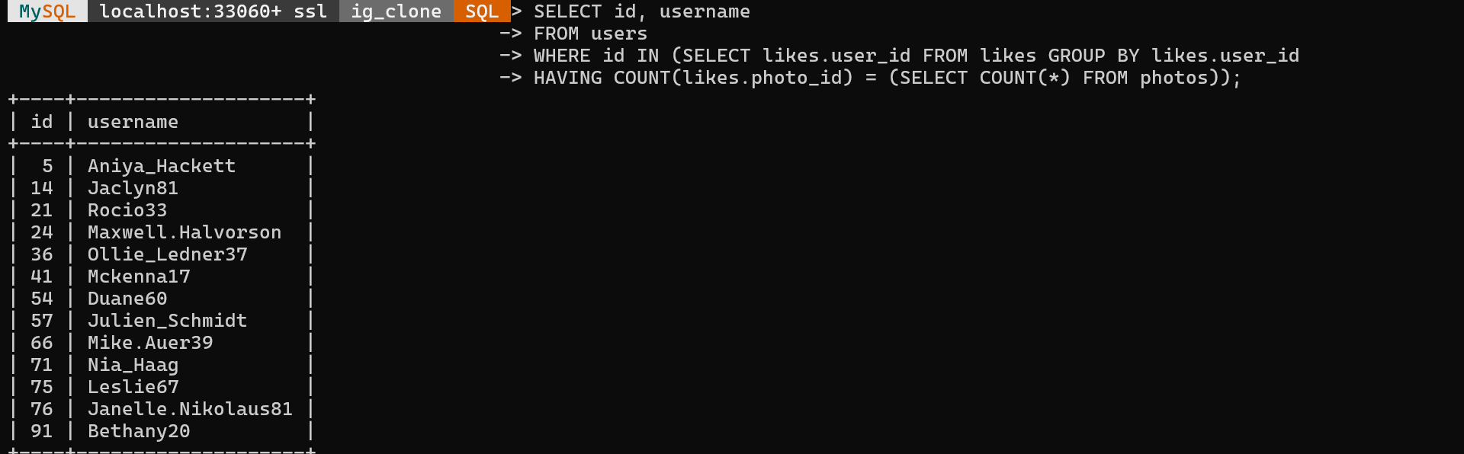
SQL Tasks
Bots and Fake Accounts
      Goal: Identify potential bots liking every photo.
      SQL Query And Output :
Insight
      These users are likely bots and need further investigation.

Slide 11
Key Insights
Marketing Insights
      Reward the oldest users to foster loyalty.
      Use top hashtags to increase engagement.
      Send targeted campaigns to inactive users.
Investor Insights
      Average posts per user provide engagement benchmarks.
      Identification of potential bots ensures platform integrity.
      Peak registration day is ideal for ad launches.

Slide 12
Results and Achievements
Successfully analyzed Instagram user data using SQL.
Delivered actionable insights for the marketing team and investors.
Gained hands-on experience with MySQL Workbench and MySQL Shell.
Learned about data-driven decision-making for user engagement and business growth.

Slide 13
Drive Link
https://drive.google.com/drive/folders/15dL3WArGy5GbH5o1BWIwy12wdPZj60hO?usp=drive_link

